Slide 1
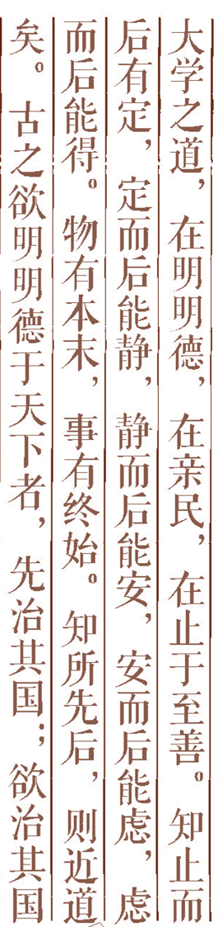
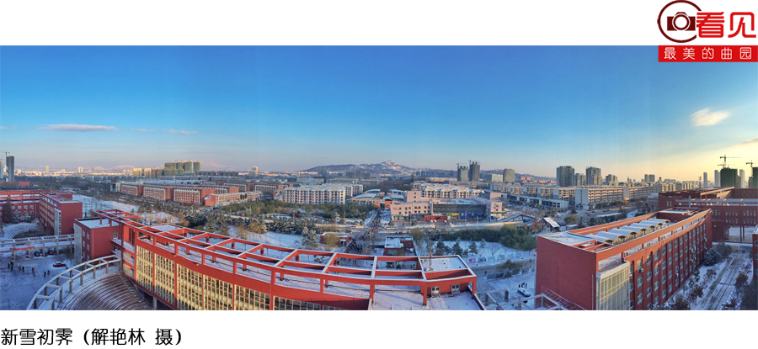

Artificial Intelligence Chapter 20 Intelligent Optimization Algorithms

Slide 2
PART 01 Intelligent Optimization Algorithm
PART 02 Ant Colony Optimization Algorithm
PART 03 Particle Swarm Optimization Algorithm
PART 04 Artificial Fish Swarm Algorithm
PART 05 Artificial Bee Colony Algorithm
PART 05 Cuckoo Search Algorithm

Slide 3

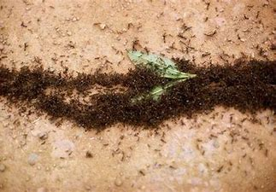
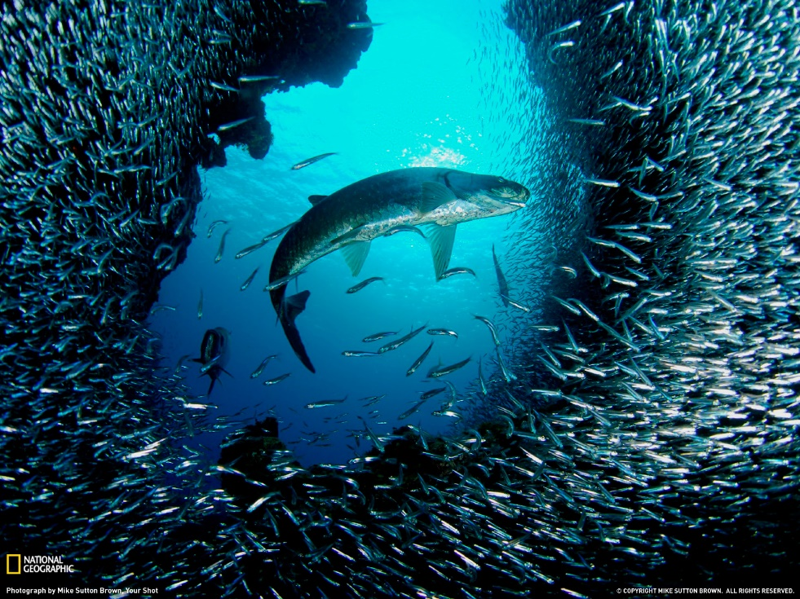
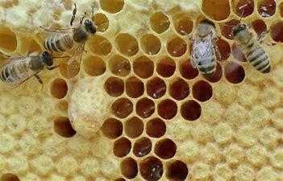
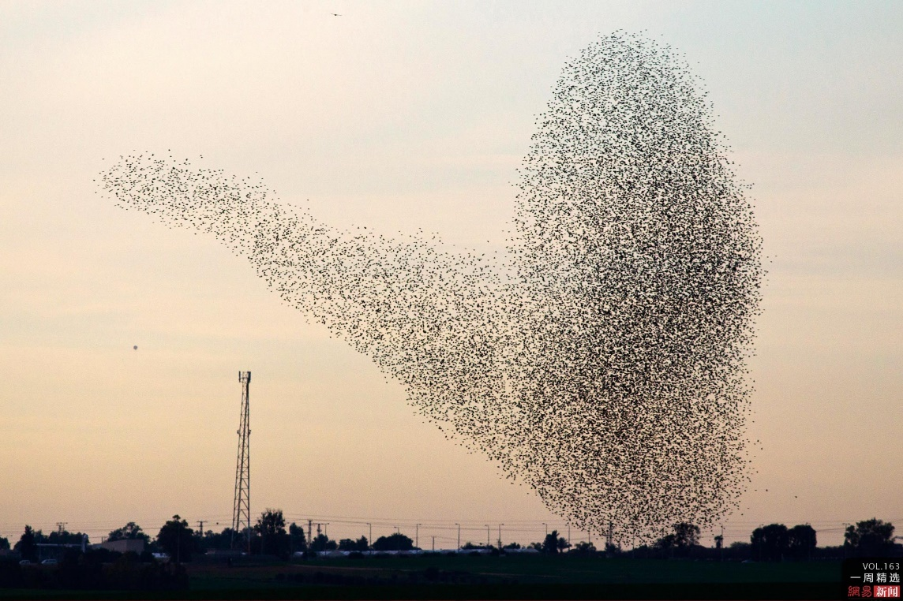

Intelligent Optimization Algorithm
延时符

Slide 4

Intelligent Optimization Algorithm
Intelligent optimization algorithm is a method to solve the optimal or satisfactory solution of complex optimization problems based on the mechanism of computational intelligence.
Swarm intelligence optimization algorithm mainly simulates the swarm behavior of insects, birds, fish and so on. These groups search for food in a cooperative way and constantly change the direction of the search by learning from their own experience and the experience of others.
.
延时符

Slide 5
Intelligent Optimization Algorithm
Feature
Typical algorithm
strong robustness
good parallelism
low demand
less communication cost
simple and easy
strong self-organization
Ant Colony Optimization
Particle Swarm Optimization
Artificial Fish Swarm Algorithm
Artificial Bee Colony Algorithm
Cuckoo Search
延时符

Slide 6
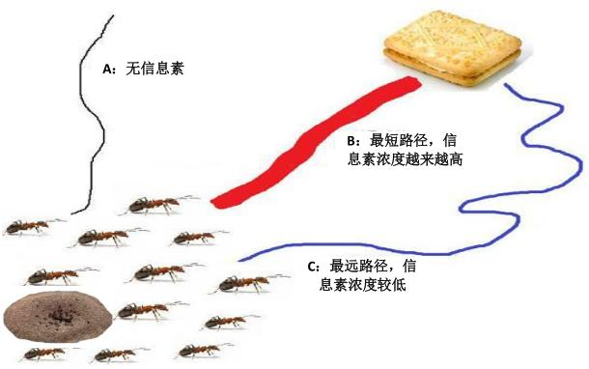
Ant Colony Optimization
Ant colony optimization (ACO) is a probabilistic algorithm used to find optimized paths. It was inspired by the behavior of ants finding paths in the process of searching for food.
This algorithm has the characteristics of distributed computation, positive information feedback and heuristic search. It is essentially a heuristic global optimization algorithm in evolutionary algorithms.
A:no pheromone
B:shortest path
C:longest path
延时符

Slide 7
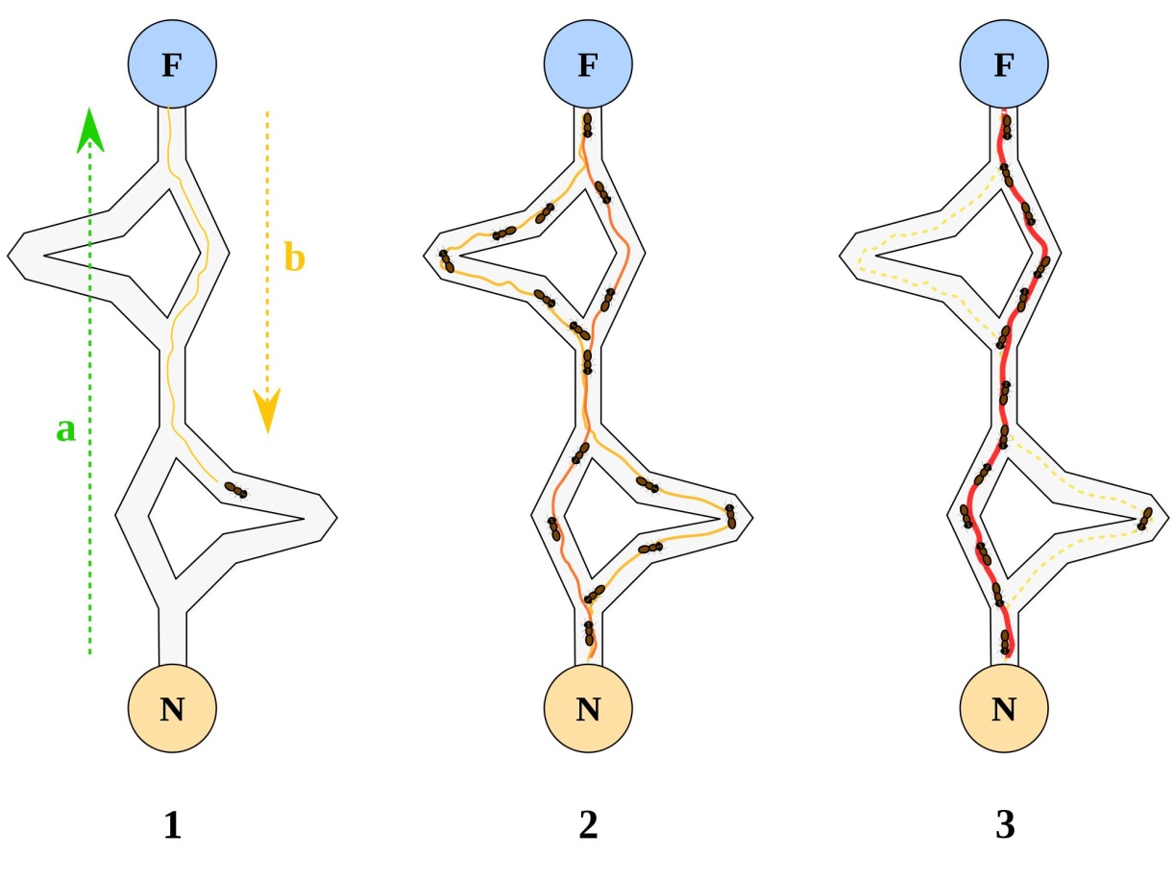
Ant Colony Optimization
Principle
As ants move, they leave a substance called pheromone on the path, and the pheromone will gradually volatilize over time.
In the process of searching for food, ants choose the direction of movement according to the concentration of pheromone, and finally reach the place where the food is.
The greater the pheromone concentration on a certain path, the more ants will pass, and the greater the probability of subsequent ants choosing the path.
延时符

Slide 8
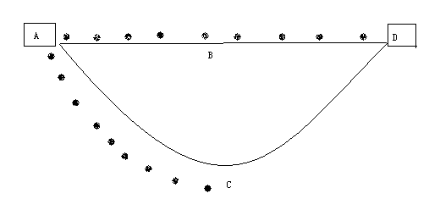
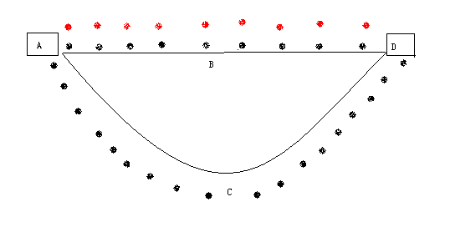
Ant Colony Optimization
①
A->D
①After 9 time units, the ants choosing the route ABD reache the end point, and the ant choosing the route ACD just reach the point C.
②
②After 18 time units, the first group receives food and returns to the starting point A after reaching the end point, while the second group just reaches the the point D.
延时符

Slide 9
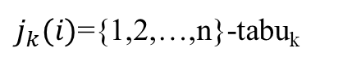
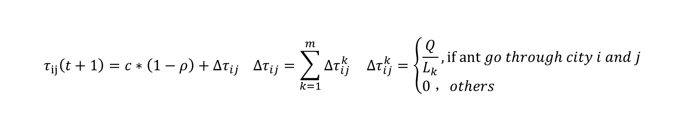
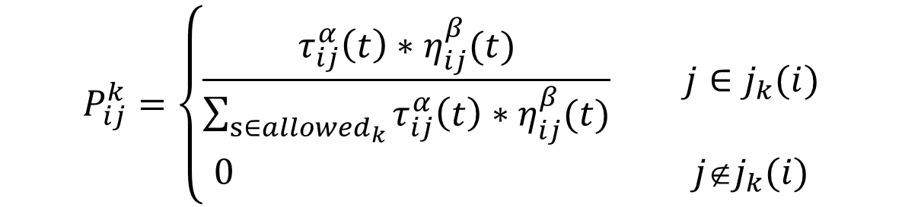
Ant Colony Optimization
Travelling Salesman Problem(TSP)
A traveling salesman has to traverse n cities, but each city can only be traversed once, and he will eventually return to the original city. Try to a traversal solution to make the total distance traveled the shortest.
①the probability of ant k moving from city i to city j:
② update pheromone：
Pheromone concentration from i to j
α:Pheromone factor
The reciprocal of the path distance from i to j
β:Heuristic function factor
$$P_{ij}^{k}=\left\{\begin{aligned}\frac{τ_{ij}^{α}\left(t\right)∗η_{ij}^{β}(t)}{\sum_{s∈{allowed}_{k}}{τ_{ij}^{α}\left(t\right)∗η_{ij}^{β}(t)}} j∈j_{k}(i) \\ 0 j∉j_{k}(i)\end{aligned}\right.$$
$j_{k}(i)$={1,2,…,n}-tabu_{k}
$$τ_{ij}\left(t+1\right)=c∗\left(1−ρ\right)+∆τ_{ij} ∆τ_{ij}=\sum_{k=1}^{m}{∆τ_{ij}^{k}} ∆τ_{ij}^{k}=\left\{\begin{aligned}\frac{Q}{L_{k}},if ant go through city i and j \\ 0 ，others \end{aligned} \right.$$
ρ:Pheromone volatilization factor
延时符

Slide 10
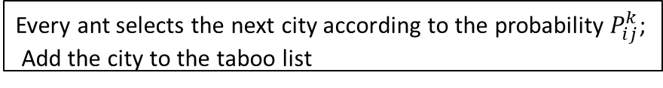
Ant Colony Optimization
start
Initialization : t=0, NC=0, $∆τ_{ij}$=C, $∆τ_{ij}$(t)=0, m , n
Taboo table index s=1; Add the starting city to the taboo list
Y
Is the taboo list full?
N
s=s+1
Algorithm flow
Every ant selects the next city according to the probability $P_{ij}^{k}$;
Add the city to the taboo list
Calculate the travel length $L_{k}$of all ants; Update the current optimal path
Calculate $∆τ_{ij}^{k}$; Update pheromone; t=t+1; NC=NC+1
N
Is the termination condition met?
Empty all taboo lists
Y
Output optimal solution
延时符

Slide 11
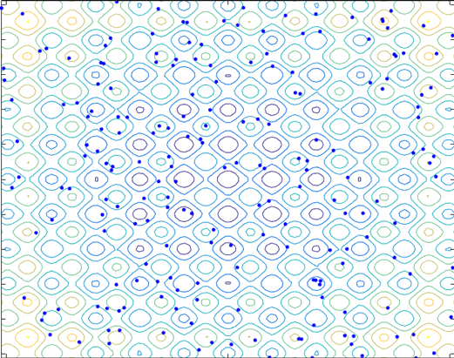
Particle Swarm Optimization
Particle Swarm optimization(PSO) is a random searching algorithm based on group collaboration developed by simulating the foraging behavior of birds.
It is simple to implement, with relatively few parameters to be adjusted, and has been widely used in the fields of function optimization, neural network training, industrial system optimization and fuzzy system control.
延时符

Slide 12
Particle Swarm Optimization
Demo animation
Note
Local region
Reasonable solution
Current optima solution
local optimal solution
Global zone

Slide 13
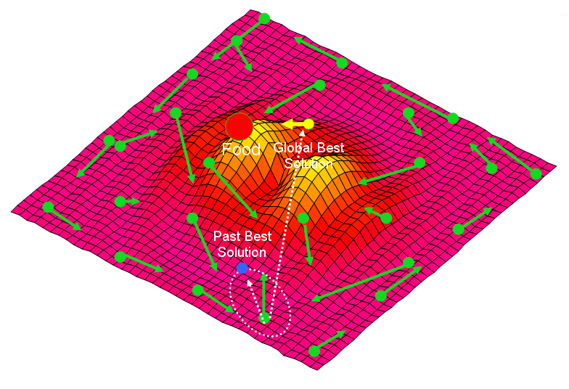
Particle Swarm Optimization
Principle
Each solution is treated as a bird, called a particle, and all particles have a fitness value, each with a velocity that determines the direction and distance of their flight. The particles update their position by tracking the individual best position(pbest) and global best position(gbest). And then they follow the current optimal particles to search in the solution space.
延时符

Slide 14
Particle Swarm Optimization
Algorithm flow
Initialize particles with random position and velocity vectors.
Evaluate each particle’s fitness based on fitness function.
Compare the current fitness to the one corresponding to its previous best position(pbest) for each particle. If fitness(xi) better than fitness(pbest) then pbest= xi.
Compare the current fitness to the one corresponding to its global best position(gbest) for each particle. If fitness(xi) better than fitness(gbest) then gbest= xi.
Update the velocity and position of each particle according to the formula.
If the termination condition is met, usually when the algorithm reaches the maximum number of iterations or the increment of the optimal fitness value is less than a given threshold, then stop. Otherwise go back to step 2.
start
Initialization
Evaluate each particle’s fitness
Calculate pbest and gbest
Update velocity and position
no
Is the termination condition met？
yes
stop
延时符

Slide 15
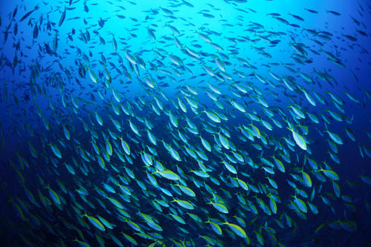
Artificial Fish Swarm Algorithm
The waters where fish live the most are among the areas with rich nutrients. Artificial fish swarm algorithm(AFSA) is based on this characteristic to simulate the fish foraging, group and tailgating behavior and find the optimal value. The algorithm mainly uses the top-down optimization mode to start with constructing the underlying behavior of individuals, and to find global optimal value by looking for the local optimal values in the fish swarm.
延时符

Slide 16
Artificial Fish Swarm Algorithm
Several typical behaviors of fish：
Foraging behavior: The fish will perceive the concentration and location of the surrounding food through its own senses such as vision and taste, and go to a place with more food.
Group behavior: refers to the behavior of fish tend to gather together to prey and avoid harm.
Tailgating behavior: It describes that if a fish in the group finds food, other fish around will follow it, causing more fish to gather in the direction of the food.
Random behavior: The behavior of each fish before it finds food is random, which helps the fish find food earlier.
延时符

Slide 17
Artificial Fish Swarm Algorithm
Principle
When the number of repetitions in foraging behavior is less frequent, the artificial fish are given the opportunity to move randomly, so that they may jump out of the local optimal solution.
Random step makes it possible for the artificial fish to turn to the global optimal solution on the way to the local optimal solution.
Crowding factor limits the scale of the cluster, so that the artificial fish can find the optimal value more widely
Group behavior can induce the artificial fish trapped in the local optimal solution to gather in the direction of the fish with global optimal solution, thus jumping out of the local optimal solution.
Tailgating behavior promotes the artificial fish to swim to a better state.
延时符

Slide 18
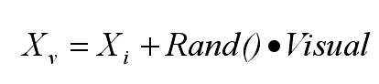
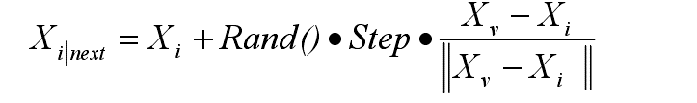
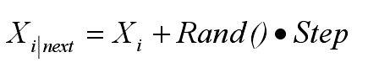
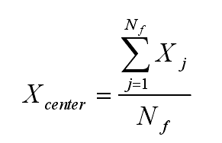
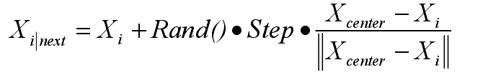
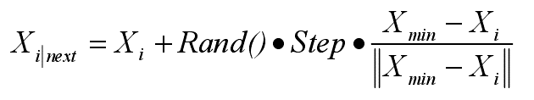

Artificial Fish Swarm Algorithm
Formula
Foraging behavior:
Group behavior:
Tailgating behavior:
延时符

Slide 19
Artificial Fish Swarm Algorithm
Algorithm flow
Initialize parameters including including population size N, initial position, Visual, step, crowding factor δ and Trynumber;
Calculate the fitness of each initial fish and assign the optimal artificial fish state and its values to the bulletin.
Evaluate and select the behaviors including foraging, group and tailgating behavior.
Perform the behavior of artificial fish, update and generate new fish swarm.
If someone is superior to the solution on the bulletin, assign the value to it.
When the optimal solution on the bulletin is within the error margin or the maximum number of iterations is reached, the algorithm ends. Otherwise, go back to step 3.
延时符

Slide 20
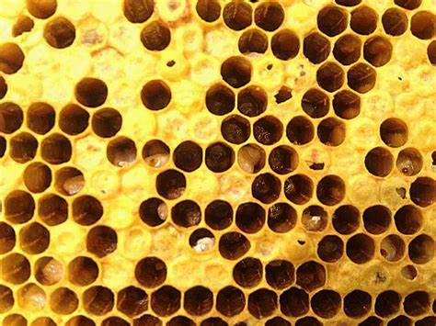
Artificial Bee Colony Algorithm
Artificial Bee Colony Algorithm(ABC) is a kind of of swarm intelligence optimization algorithm that imitates the honey harvesting mechanism of bees. The model of the bee colony is composed of food resources(FR), employed foragers(EF), unemployed foragers(UF). The unemployed foragers are divided into scout bees and onlooker bees. There are two basic behavioral pattern, including recruiting bees for food sources and abandoning food source.
延时符

Slide 21
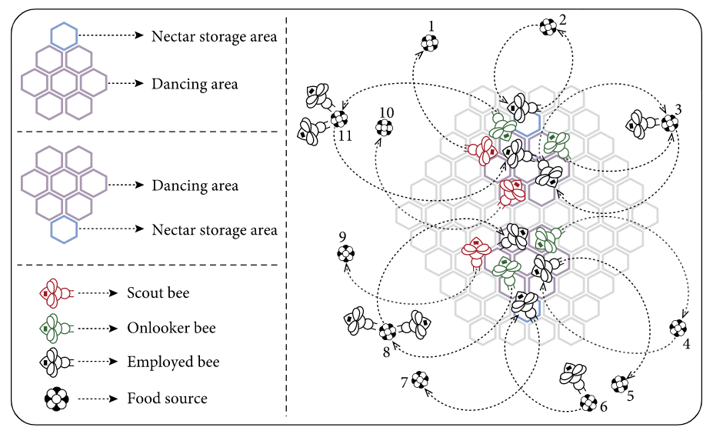
Artificial Bee Colony Algorithm
Principle
When ABC solves the optimization problem, the location of the food source is abstracted into a point in the solution space. The process of collecting nectar (food source) is also the process of searching for the optimal solution. Considering the global optimization problem (P), then the set of multiple feasible solutions of the P is called a population. Each element (feasible solution) in the population is called a food source. The number of solutions (SN) is equal to the number of employed or onlooker bees.
延时符

Slide 22
Artificial Bee Colony Algorithm
Principle
Not nectar source
Nectar source A
Suppose there are two discovered nectar sources A and B. At the beginning, unemployed foragers did not have any information about nectar sources. They have two options:
As scout bees. They spontaneously search for nectar sources near the hive ('S' line).
After observing the swing dance of other bees, they can be recruited and start searching for nectar sources based on the information obtained.
EF1
EF2
UF
EF1
EF2
S
Unemployed foragers
Unloading honeycomb A
S
UF
R
Swing dance area A
EF1
R
S
Swing dance area B
EF1
Unloading honeycomb B
Unemployed foragers
UF
EF2
S
EF1
UF
EF1
Not nectar source
EF2
Nectar source B
延时符

Slide 23
Artificial Bee Colony Algorithm
Principle
When unemployed foragers find a new nectar source, they rely on their own ability to remember the location of the nectar source and quickly collect nectar. Therefore, the unemployed bee becomes an employed forager. When it returns to the hive after collecting nectar, it has the following choices:
(1) Give up the nectar source (low yield) and become the onlooker bee waiting for work(UF).
(2) Before returning to the same nectar source, dance to recruit other hive partners .
(3) Do not recruit other bees and continue to collect nectar.
延时符

Slide 24
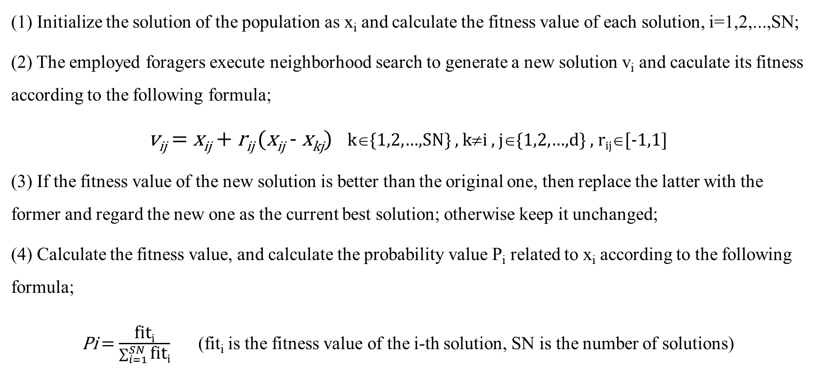
Artificial Bee Colony Algorithm
Algorithm flow
(1) Initialize the solution of the population as x_{i} and calculate the fitness value of each solution, i=1,2,...,SN;
(2) The employed foragers execute neighborhood search to generate a new solution v_{i} and caculate its fitness according to the following formula;
v_{ij} = x_{ij} + r_{ij} (x_{ij} - x_{kj}) k∈{1,2,…,SN} , k≠i , j∈{1,2,…,d} , r_{ij}∈[-1,1]
(3) If the fitness value of the new solution is better than the original one, then replace the latter with the former and regard the new one as the current best solution; otherwise keep it unchanged;
(4) Calculate the fitness value, and calculate the probability value P_{i} related to x_{i} according to the following formula;
Pi = $\frac{\text{fit}\text{i}}{\sum_{i=1}^{SN}{\text{fit}\text{i}}}$(fit_{i} is the fitness value of the i-th solution, SN is the number of solutions)
延时符

Slide 25
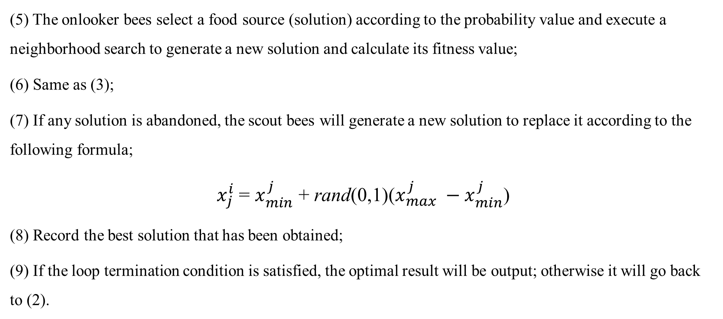
Artificial Bee Colony Algorithm
Algorithm flow
(5) The onlooker bees select a food source (solution) according to the probability value and execute a neighborhood search to generate a new solution and calculate its fitness value;
(6) Same as (3);
(7) If any solution is abandoned, the scout bees will generate a new solution to replace it according to the following formula;
$x_{j}^{i}$ = $x_{min}^{j}$ + rand(0,1)($x_{max}^{j} −x_{min}^{j}$)
(8) Record the best solution that has been obtained;
(9) If the loop termination condition is satisfied, the optimal result will be output; otherwise it will go back to (2).
延时符

Slide 26
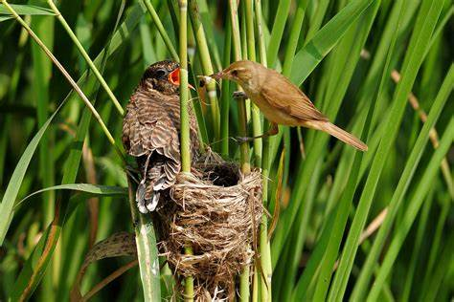
Cuckoo Search Algorithm
Cuckoo search is an algorithm that effectively solves the optimization problem by simulating the Brood Parasitism of some species of cuckoo. It is a new meta-heuristic search algorithm. The idea is mainly based on two strategies: cuckoo's nest parasitism and Levy flight.
An efficient search mode can be achieved by searching for an optimal nest to hatch their own eggs by means of random walk.
延时符

Slide 27
Cuckoo Search Algorithm
Principle
Nest parasitism refers to the use of other birds’ nests to hatch their own eggs. To improve the survival rate of eggs, they must destroy or camouflage the host's eggs. If the egg is found by the host, it will search for a new nest or destroy the egg. The quality of nest directly affects the survival rate of the next generation.
The cuckoo algorithm is simulated through the process of cuckoo searching for the nest. It is based on three ideal rules:
(1) Cuckoos lay only one egg at a time, and randomly select nests to hatch it;
(2) In a randomly selected set of nests, the best nest will be retained for the next generation;
(3) The number of available nests is fixed. The probability that the host can find a foreign egg is Pa∈[0, 1].
延时符

Slide 28
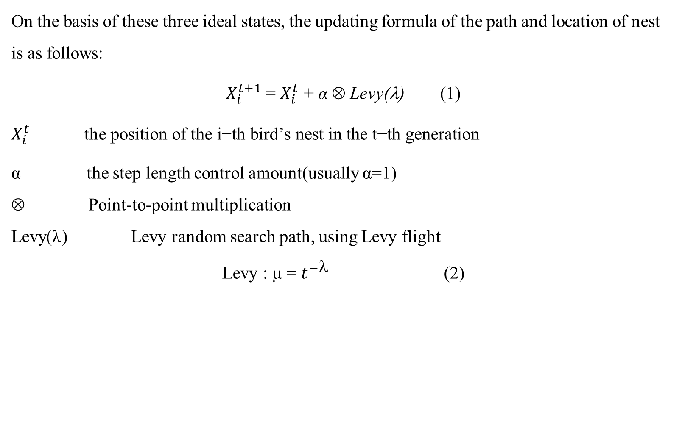
Cuckoo Search Algorithm
Principle
On the basis of these three ideal states, the updating formula of the path and location of nest is as follows:
$X_{i}^{t+1}$ = $X_{i}^{t}$ + α ⊗ Levy(λ) (1)
$$X_{i}^{t} \text{the} \text{position} \text{of} \text{the} \text{i}\text{−}\text{th} \text{bird}\text{’}\text{s} \text{nest} \text{in} \text{the} \text{t}\text{−}\text{th} \text{generation}$$
α the step length control amount(usually α=1)
Point-to-point multiplication
Levy(λ) Levy random search path, using Levy flight
Levy : μ = $t^{−}$ (2)
延时符

Slide 29
Cuckoo Search Algorithm
Cuckoo Search
1: Objective function f(x), x = (x₁, …, x_{d})^{T}
2: Generate the initial population x_{i} of n hosts
3: while(t< MaxN) or (stop criterion) do
4: Pick a cuckoo randomly
5: Generate a solution by Levy Flight
6: Evaluate the quality of the solution or the value of the Objective function f_{i}
7: Pick one nest(j) from n nests randomly
8: if f_{i} < f_{j} then
9: Replace j with i
10: end if
11: Some bad nests are abondoned
12: New nests or solutions are generated according to formula (1)
13: Save the optimal solution
14: Sort the solutions to find the current best one
15: Update t t+1
16: end while
Pseudocode
延时符

Slide 30
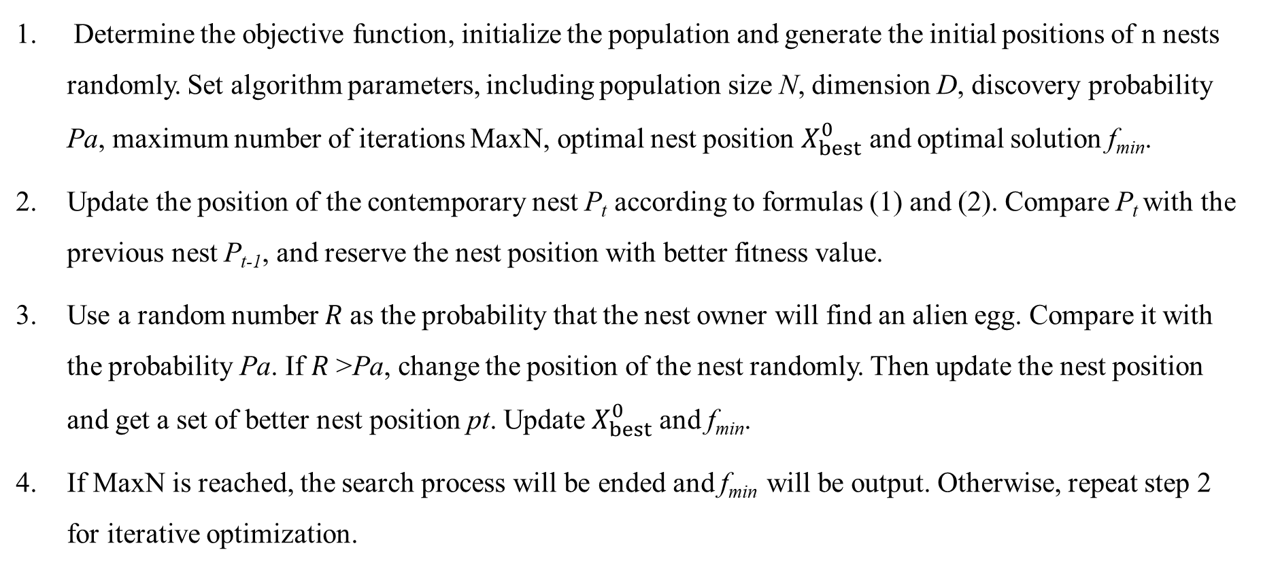
Artificial Bee Colony Algorithm
Algorithm flow
Determine the objective function, initialize the population and generate the initial positions of n nests randomly. Set algorithm parameters, including population size N, dimension D, discovery probability Pa, maximum number of iterations MaxN, optimal nest position $X_{best}^{0}$ and optimal solution f_{min}.
Update the position of the contemporary nest P_{t} according to formulas (1) and (2). Compare P_{t} with the previous nest P_{t-1}, and reserve the nest position with better fitness value.
Use a random number 𝑅 as the probability that the nest owner will find an alien egg. Compare it with the probability Pa. If 𝑅 >Pa, change the position of the nest randomly. Then update the nest position and get a set of better nest position pt. Update $X_{best}^{0}$ and f_{min}.
If MaxN is reached, the search process will be ended and f_{min} will be output. Otherwise, repeat step 2 for iterative optimization.
延时符

Slide 31
课程总结以及课程思政
Contents | 课程思政
1. History of AI | 从哲学的否定之否定规律导入AI新技术的产生与发展
2. Languages for AI | 例如Python，融入就业因素，可以把技术做一些简单扩展
3.Search Algorithms | 通过九宫重排对算法不断优化，提升质疑精神。
4. Machine Learning | 通过学习“圆”或“黄色”来解释“物以类聚，人以群分”。 要在一起积极向上的群体中发展自己，提升自己。

Slide 32
Contents | 课程思政
5. NLP | 通过分析汉语的语言特点，进行知识表示与获取，进而提出一些语义学，语用学以及语言心理学方面的基本知识，激励学生进行一些语言获取等方面的实践锻炼。
6. Intelligent Answering System | 例如科大讯飞等平台的局限性，思考如何突破局限性以及如何实现用户友好及声纹识别等，让学生意识到自主创新重大意义。
7.Intelligent Algorithms | 辩论算法复杂性与硬件之间的关系。针对TSP问题找不同的算法，并对比分析不同算法的优缺点，进而激发自己设计一个“完美的”AI算法，培养发散思维能力。
8.Resolution Refutation | 思考如何让机器实现定理的自动证明，需要机器什么语言。

